Slide 1
PBL
SENSOR GLOVE FOR SIGN LANGUAGE TRANSLATION
FY BTech (IT) Semester II ( 2024-25)
Apoorva Rajpurohit (16010424103)
Sadhana Ramesh Kumar (16010424104)
Rimjhim Ranjan (16010424105)
Nidhi Rasalkar (16010424106)
Bhoomi Sahay (16010424107)

Slide 2
Theme chosen for Project
The theme of our project is "Bridging the Communication Gap with Smart Assistive Technology", emphasizing accessibility, inclusivity, and innovation. It focuses on leveraging sensor technology to translate sign language into text, enhancing communication for individuals who are deaf or hard of hearing.

Slide 3
Need Statement
In the deaf and hard-of-hearing community, effective communication can be a significant barrier, especially in situations where sign language interpreters are unavailable. Despite advances in technology, current methods for sign language translation are often limited, either relying on human interpreters or offering devices that lack real-time functionality, portability, or affordability. There is a critical need for an efficient, accessible, and real-time solution to bridge this communication gap. Our project aims to develop a sensor-equipped glove that translates sign language into text in real-time, providing individuals with hearing impairments a more seamless and independent way to interact with the world around them.
How Our Project Improves Upon These Solutions:
Real-Time, Accurate Translation
Portability & Independence
Cost-Effective

Slide 4
Problem Statement
Objectives:
Design a sensor glove with flex sensors and an accelerometer to capture hand gestures.
Process sensor data using Arduino Nano to recognize sign language gestures.
Optimize gesture recognition for accurate, real-time feedback.
Create an intuitive, user-friendly interface for both deaf and non-deaf users.
Ensure power efficiency for long-term use of the system.

Slide 5
Constraints:
Sensor Accuracy: Flex sensors may not perfectly capture small hand movements.
Limited Gesture Recognition: Only a predefined set of gestures may be recognized.
Real-Time Performance: Ensuring low-latency processing and feedback could be challenging.
Power Consumption: Battery life could be limited with continuous use of sensors.

Slide 6
Final Problem Statement
This project aims to develop a wearable sensor glove that translates sign
language gestures into text in real-time. Using flex sensors and an accelerometer, the glove captures hand movements, processes the data via Arduino, converts the gestures into text and prints the output in the serial monitor. The goal is to bridge the communication gap between hearing-impaired individuals and others.

Slide 7
Scope of Project
Key Features
Sensor Integration: Utilize flex sensors, accelerometers, etc. to detect hand and finger movements.
Real-Time Translation: Convert sign language gestures into readable text
Wireless Connectivity: Use Bluetooth or Wi-Fi to transmit data to a mobile or desktop application.
User Interface: A mobile or desktop application for text output, customization, and calibration.
Target Users
Individuals who are deaf or hard of hearing.
People who interact with sign language users (e.g., healthcare professionals, educators).
Institutions focused on accessibility and inclusivity.
Technologies Involved
Hardware: Sensors (flex, IMU), microcontrollers (Arduino, ESP32, Raspberry Pi).
Software: Programming, mobile app development [MIT app inventor], Arduino IDE
Communication Protocols: Bluetooth, Wi-Fi, or wired connection.

Slide 8
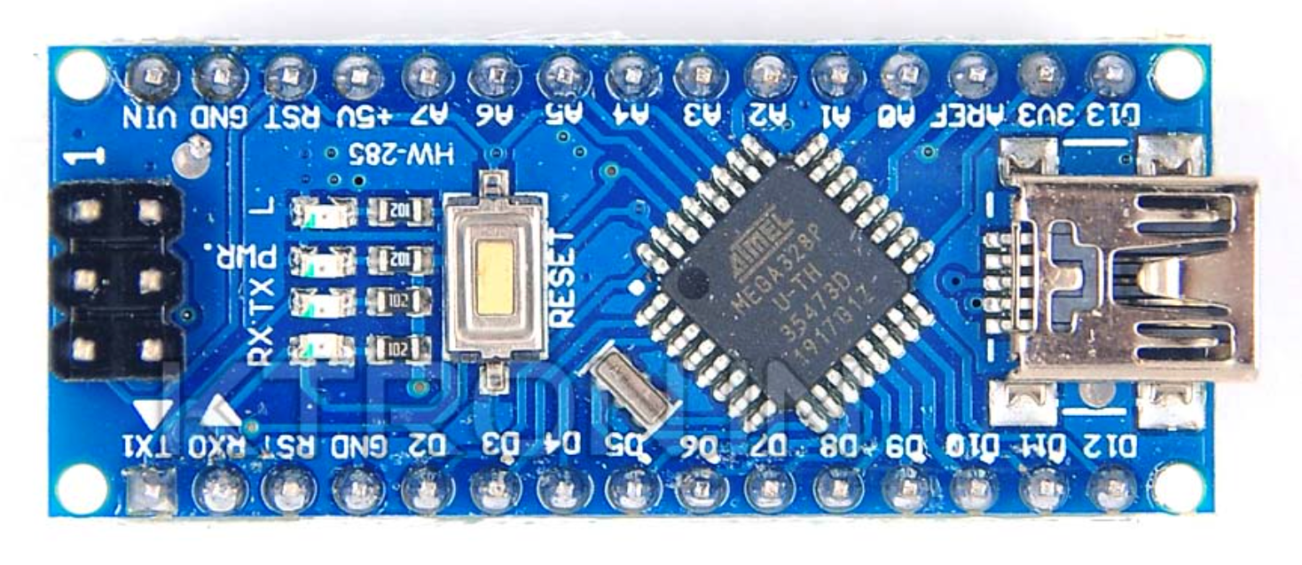
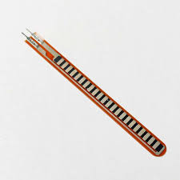
Hardware Requirements
Flex Sensors
Accelerometer (ADXL335) – Captures hand orientation and motion.
Microcontroller (Arduino Nano) – Processes sensor data and transmits it.
Glove – Acts as a base for mounting sensors.
Resistors & Connecting Wires – Power Source (Battery/USB Power Supply) – Powers the system.

Slide 9
Software Requirements
Arduino IDE
Arduino IDE is a user-friendly development platform for programming Arduino boards. It uses C/C++ and provides features like syntax highlighting, code auto-completion, and error checking. The IDE also includes libraries that simplify interfacing with sensors, displays, and other components.

Slide 10
Timeline Chart
01-2025
02-2025
03-2025
04-2025
W1
W2
W3
W4
W1
W2
W3
W4
W1
W2
W3
W4
W1
W2
RESEARCH AND PLANNING
HARDWARE SELECTION
PROTOTYPE DEVELOPMENT
SOFTWARE DEVELOPMENT
INTEGRATION AND TESTING
TESTING AND REFINEMENT
DOCUMENTATION AND FINALIZATION

Slide 11
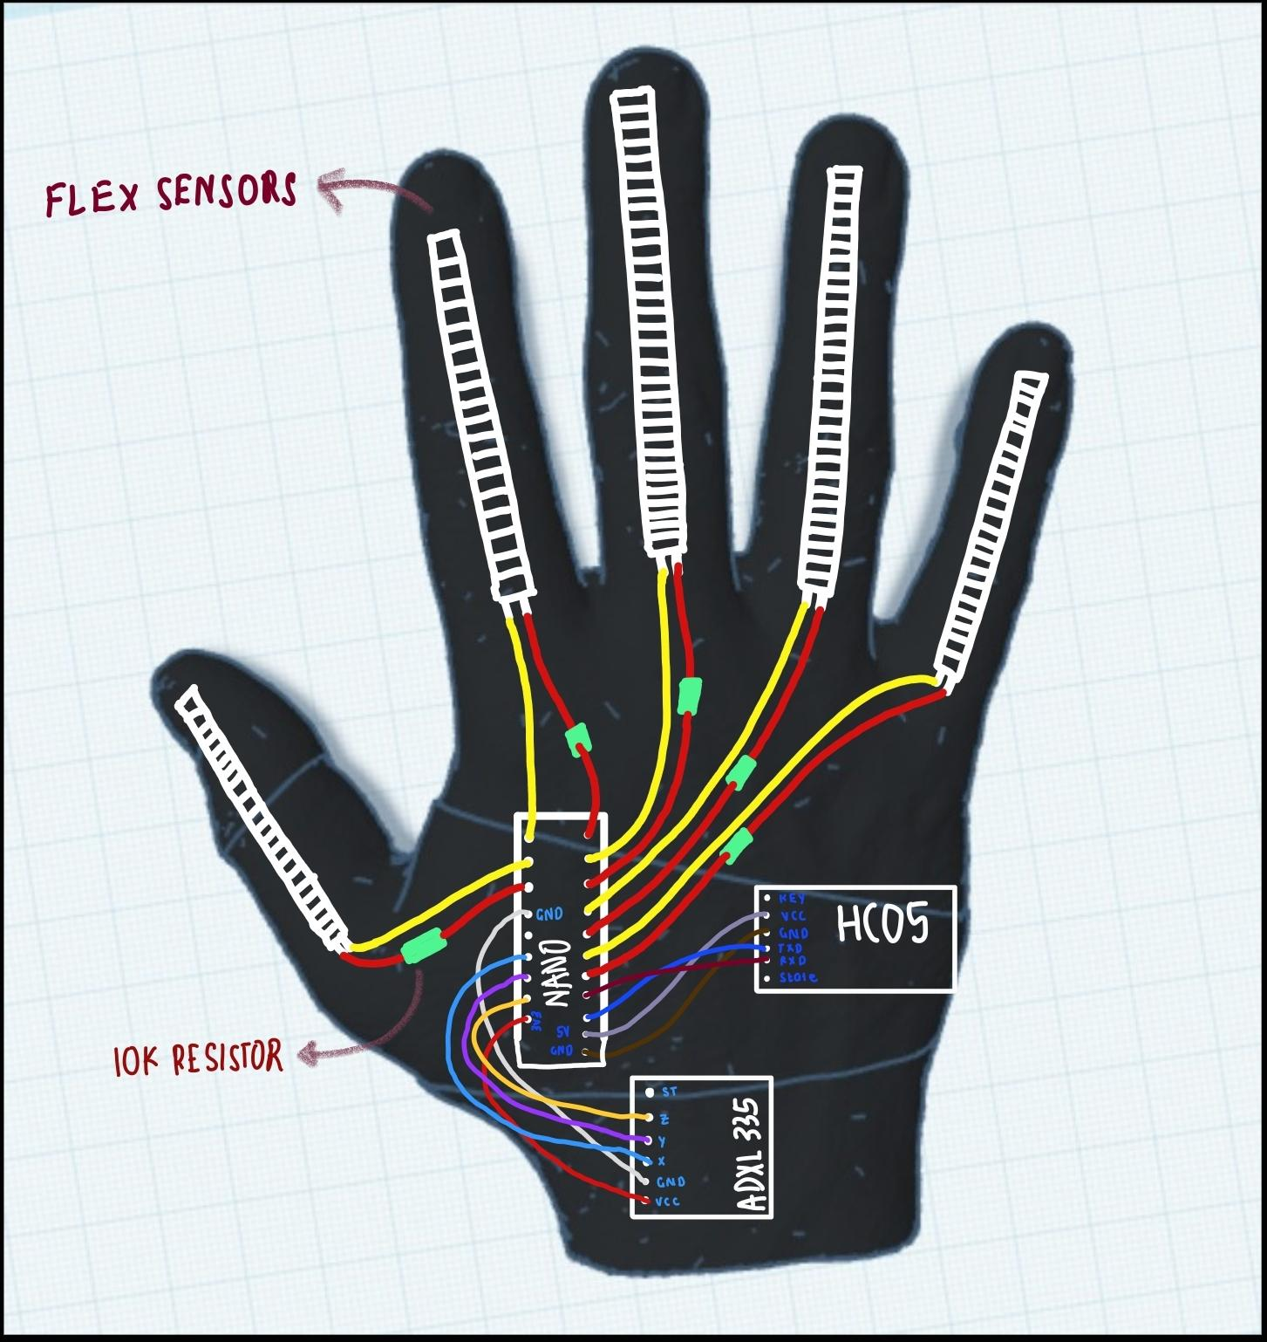
Conceptual Designs

Slide 12
Literature Survey
Title with year of Publication | Authors | Methodology/ Algorithm | Key Results / Findings | Remarks ( Based on your understating) | Link for article
A Comparative Review on Applications of Different Sensors for Sign Language Recognition (2022)
Muhammad Saad Amin , Syed Tahir Hussain Rizvi , and Md. Murad Hossain
1) The research focused on sensor-based sign language recognition systems embedded with various modules.
2) Studies included in the review examined both existing and newly proposed systems, evaluating their effectiveness in translating sign languages into text.
1) Different types of sensors, such as flex sensors, gyroscopes, and accelerometers, play a crucial role in accurate gesture recognition
2) System complexity, high computational requirements, and cost issues are major challenges.
1) Arduino Nano is the most commonly used microcontroller
2) Some letter like J and Z require arm movement which is hard to capture through the glove
https://www.mdpi.com/2313-433X/8/4/98

Slide 13
Title with year of Publication | Authors | Methodology/ Algorithm | Key Results / Findings | Remarks ( Based on your understating) | Link for article
A Review on Systems-Based Sensory Gloves for Sign Language Recognition State of the Art between 2007 and 2017 (2018)
Mohamed Aktham Ahmed 1,2, Bilal Bahaa Zaidan 1 , Aws Alaa Zaidan 1,*, Mahmood Maher Salih 1,2 and Muhammad Modi bin Lakulu 1
1) The study answers six key research questions related to types of sensors, system effectiveness, recognized gestures, and sign language variations​
2) Results showed that glove-based systems achieved high accuracy (>90%) but faced challenges in dynamic gesture recognition and cost-effectiveness​
1) The study analyzed different sensor-equipped gloves using flex sensors, accelerometers, gyroscopes, and magnetometers.
2) Systems were primarily designed for static gestures, with dynamic gesture recognition still being a challenge.
1) Some gestures have similar shapes, such as "M," "N," "S," and "T" in ASL, causing misclassification
2) Most systems only translate sign language to text or speech., a reverse system is still lacking
https://www.mdpi.com/1424-8220/18/7/2208

Slide 14
Title with year of Publication | Authors | Methodology/ Algorithm | Key Results / Findings | Remarks ( Based on your understating) | Link for article
A Systematic Review on Systems-Based Sensory Gloves for Sign Language Pattern Recognition: An Update From 2017 to 2022 (2022)
ZINAH RAAD SAEED 1 , ZURINAHNI BINTI ZAINOL 1 , B. B. ZAIDAN 2 , AND A. H. ALAMOODI 3
1) The search covered studies from 2017 to 2022, ensuring the review included the most recent advancements
2) A total of 115 studies were included in the qualitative synthesis he selected studies were categorized based on:
- Types of sensors used
- Gesture recognition techniques
- Number and type of gestures recognize
- Performance metrics
The study analyzed technical challenges, system limitations, and future recommendations
1) Sensor-equipped gloves allow direct acquisition of hand movements, making them more accurate than vision-based recognition.
2) Unlike camera-based systems, sensor-based gloves are not affected by lighting or environmental conditions
1) The trade-off between sensor sensitivity and device durability should be optimized
2) Most research only covers isolated words, while continuous sign language recognition remains a challenge​
https://ieeexplore.ieee.org/stamp/stamp.jsp?arnumber=9938436

Slide 15
Block Diagram of Project
FLEX SENSORS
[FINGER BENDING]
SENSOR GLOVE FOR SIGN LANGUAGE TRANSLATION
ACCELEROMETER
[HAND MOTION]
MICROCONTROLLER UNIT [MCU]
ARDUINO NANO R3:
- Collects sensor data
-Filters & processes data
-Converts sensor signals into text
OUTPUT MODULE [TEXT]
- Displayed in the serial monitor

Slide 16
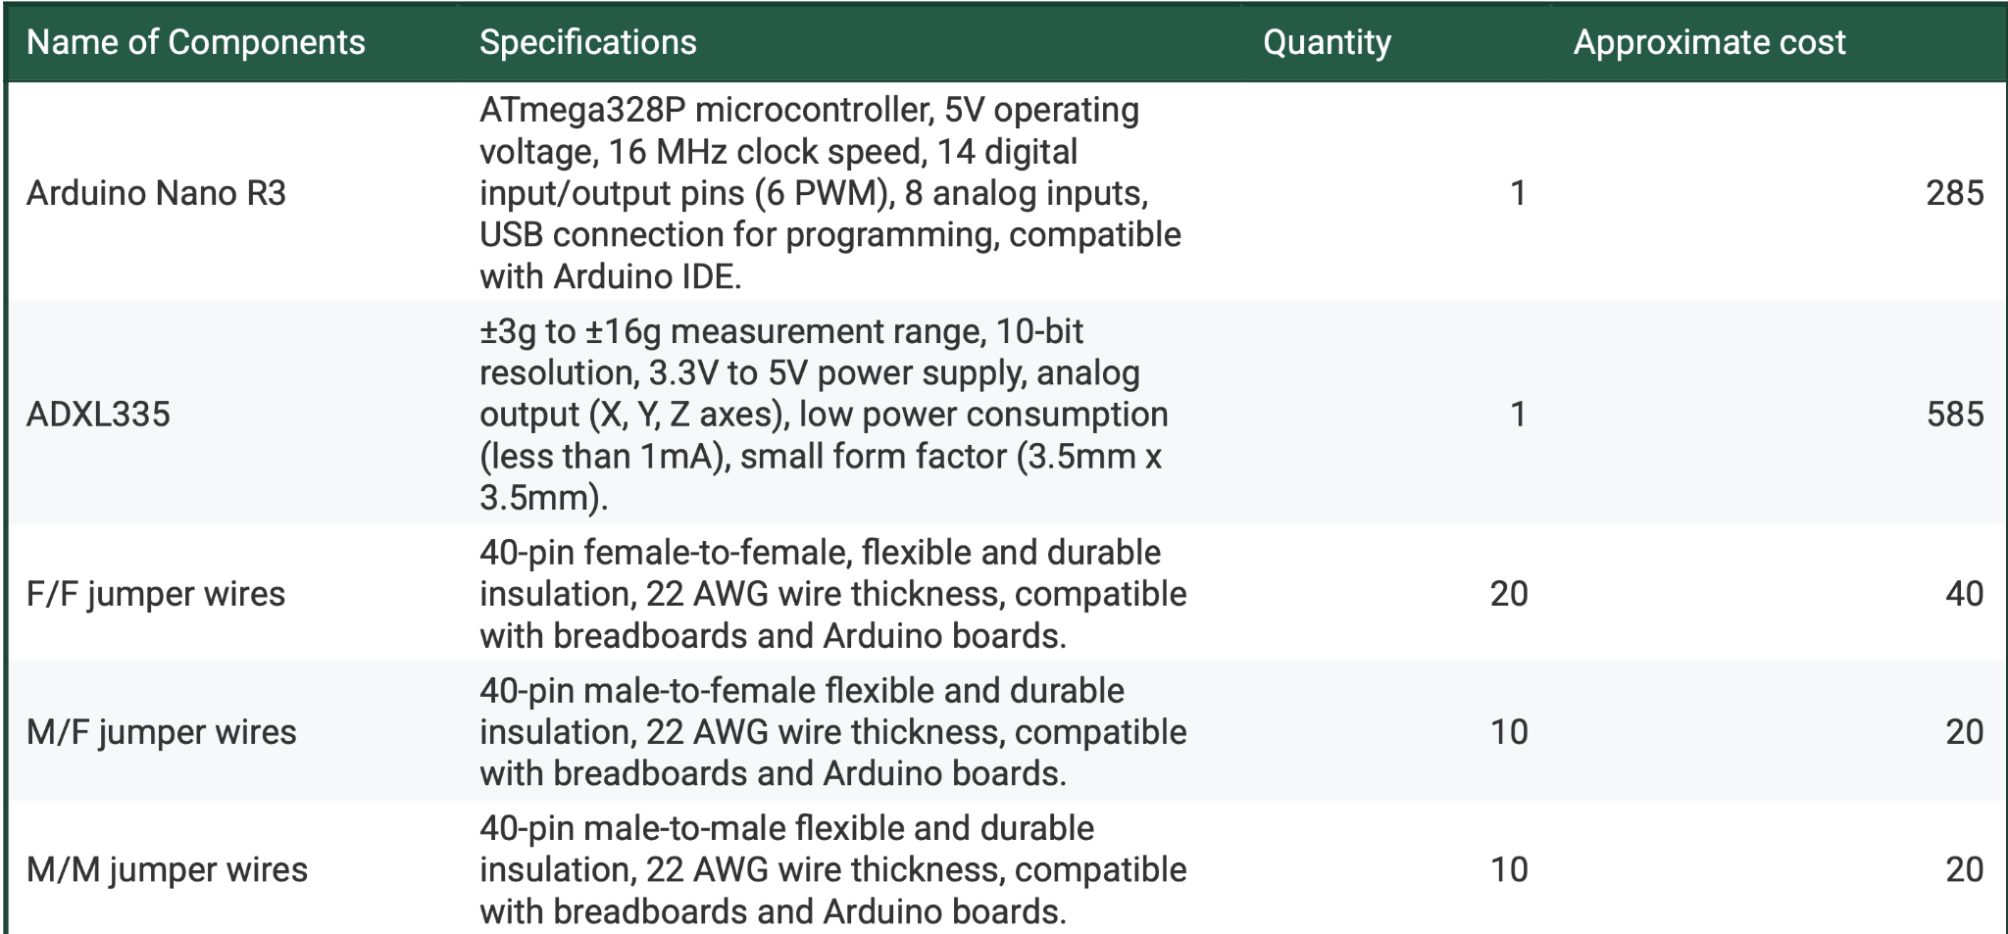
Project Cost Sheet

Slide 17
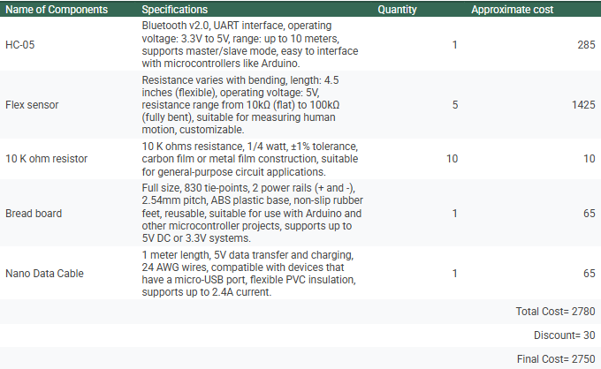

Slide 18
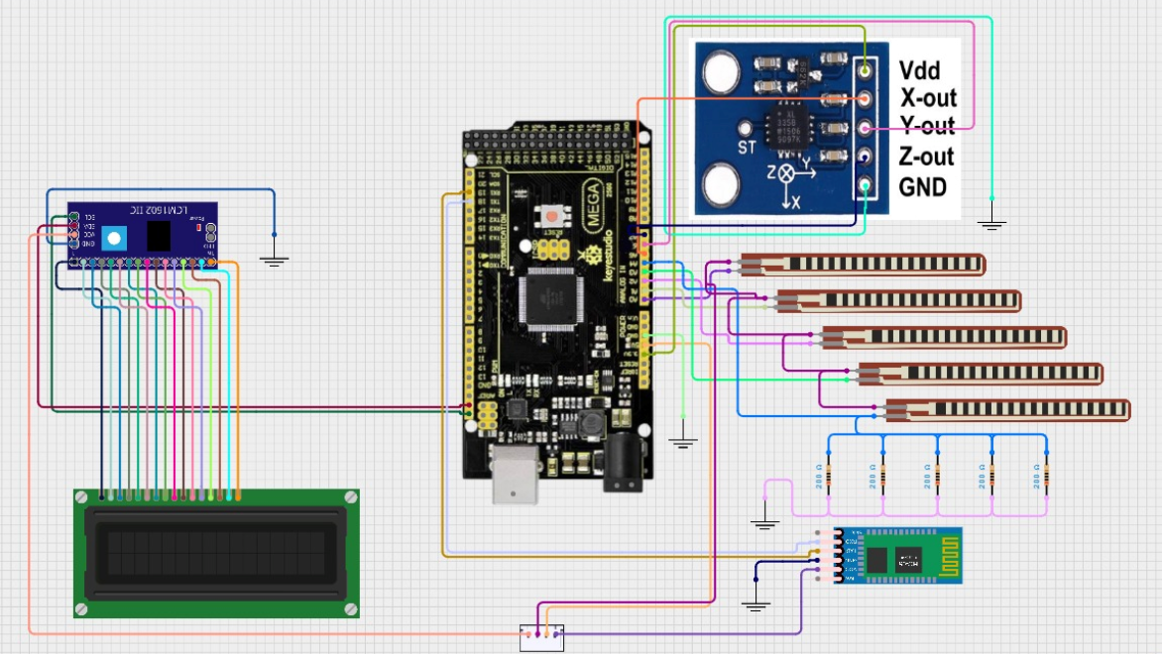
Proposed Circuit Diagram

Slide 19
Project Status
Work Completed till Date
hardware selection
obtaining components
rough conceptual design
circuit connection
Arduino coding done
Work To be completed
app development (testing remaining)

Slide 20
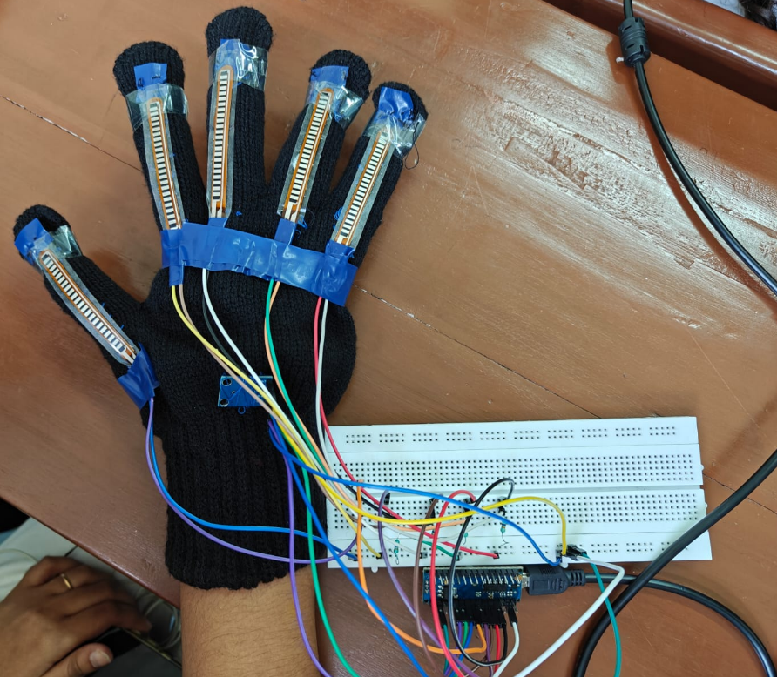
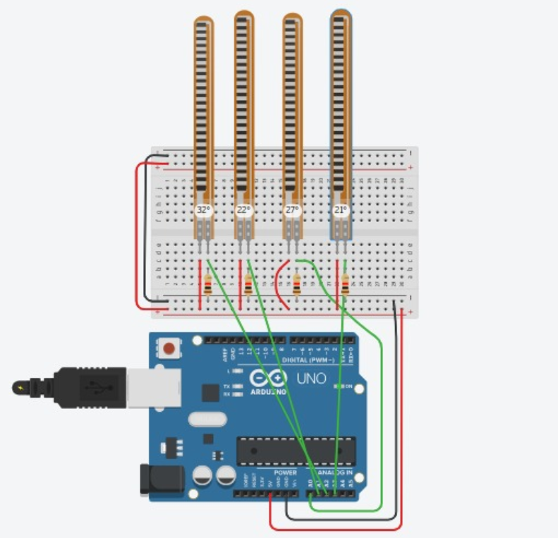
Results
Video link for simulation:
https://www.tinkercad.com/things/atTloX58E2f-flex-sensors?sharecode=ud3OEa5eWFq3HXzpsOZCOC-ZVgWU2i1VCv_d7puSEBM

Slide 21
Results
Drive Link for Videos of Project:
https://drive.google.com/drive/folders/1Zwkmpcionbk1KfdoYDJumv0189jVd8Ol?usp=sharing

Slide 22
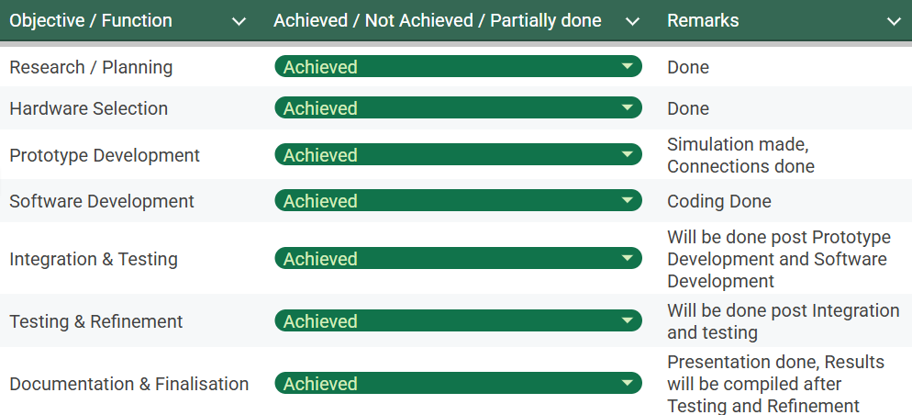
Results

Slide 23
References
https://www.mdpi.com/2313-433X/8/4/98
https://www.mdpi.com/1424-8220/18/7/2208
https://ieeexplore.ieee.org/stamp/stamp.jsp?arnumber=9938436
https://citeseerx.ist.psu.edu/document?repid=rep1&type=pdf&doi=97fc603a799842630748089e090b1e9b97e5b489
https://www.cirkitstudio.com/
https://www.tinkercad.com/

